Slide 1
Graphing Relationships

Slide 2
Warm Up
State whether each word or phrase represents an amount that is increasing, decreasing, or constant.
1. stays the same
2. rises
3. drops
4. slows down
constant
increasing
decreasing
decreasing

Slide 3
Graphs can be used to illustrate many different situations. For example, trends shown on a cardiograph can help a doctor see how a patient’s heart is functioning.
To relate a graph to a given situation, use key words in the description.

Slide 4
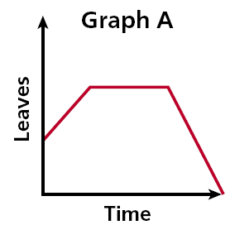
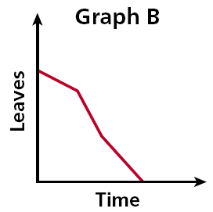
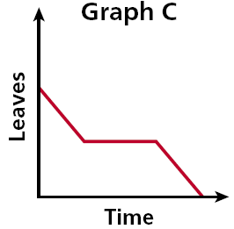
Example 1: Relating Graphs to Situations
Each day several leaves fall from a tree. One day a gust of wind blows off many leaves. Eventually, there are no more leaves on the tree. Choose the graph that best represents the situation.
Step 1 Read the graphs from left to right to show time passing.

Slide 5
Check It Out! Example 1
The air temperature increased steadily for several hours and then remained constant. At the end of the day, the temperature increased slightly before dropping sharply. Choose the graph that best represents this situation.
Step 1 Read the graphs from left to right to show time passing .

Slide 6
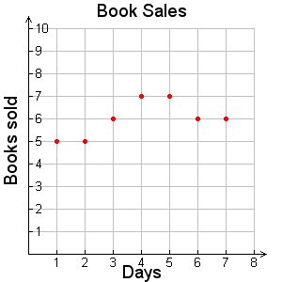
Sketching Graphs for Situations
Sketch a graph for the situation. Tell whether the graph is continuous or discrete.
A small bookstore sold between 5 and 8 books each day for 7 days.
The number of books sold (y-axis) varies for each day (x-axis).
Since the bookstore can only sell whole numbers of books, the graph is 7 distinct points.
The graph is discrete, not continuous

Slide 7
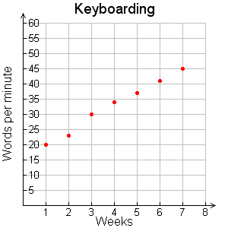
Sketch a graph for the situation. Tell whether the graph is continuous or discrete.
Jamie is taking an 8-week keyboarding class. At the end of each week, she takes a test to find the number of words she can type per minute. She improves each week.
Each week (x-axis) her typing speed is measured. She gets a separate score (y-axis) for each test.
Since each test score is a whole number, the graph consists of 8 distinct points.
The graph is discrete.

Slide 8
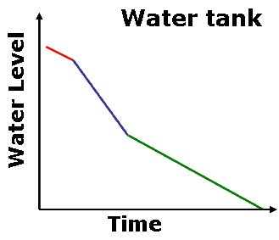
Sketch a graph for the situation. Tell whether the graph is continuous or discrete.
Henry begins to drain a water tank by opening a valve. Then he opens another valve. Then he closes the first valve. He leaves the second valve open until the tank is empty.
As time passes while draining the tank (moving left to right along the x-axis) the water level (y-axis) does the following:
• initially declines
• decline more rapidly
• and then the decline slows down.
The graph is continuous.

Slide 9
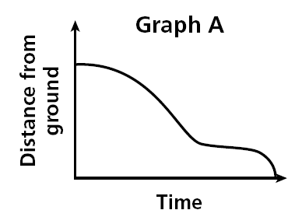
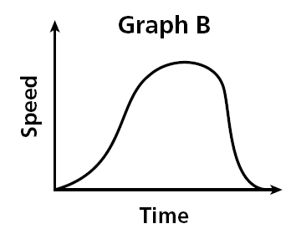
Both graphs show a relationship about a child going down a slide. Graph A represents the child’s distance from the ground related to time. Graph B represents the child’s Speed related to time.

Slide 10
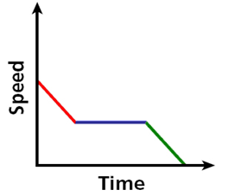
Example 3: Writing Situations for Graphs
Write a possible situation for the given graph.
Step 1 Identify labels. x-axis: time y-axis: speed
Step 2 Analyze sections. over time, the speed:
• initially decreases,
• remains constant,
• and then decreases to zero.
Possible Situation:
A car approaching traffic slows down, drives at a constant speed, and then slows down until coming to a complete stop.

Slide 11
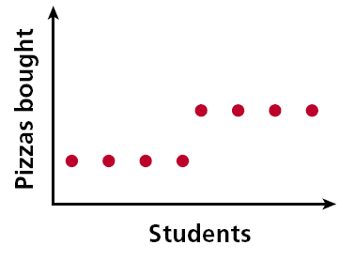
Check It Out! Example 3
Write a possible situation for the given graph
Step 1 Identify labels. x-axis: students y-axis: pizzas
Step 2 Analyze sections. As students increase, the pizzas do the following:
• initially remains constant,
• and then increases to a new constant.
Possible Situation:
When the number of students reaches a certain point, the number of pizzas bought increases.

Slide 12
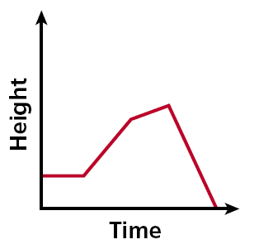
Lesson Quiz: Part I
1. Write a possible situation for the given graph.
Possible Situation: The level of water in a bucket stays constant. A steady rain raises the level. The rain slows down. Someone dumps the bucket.

Slide 13
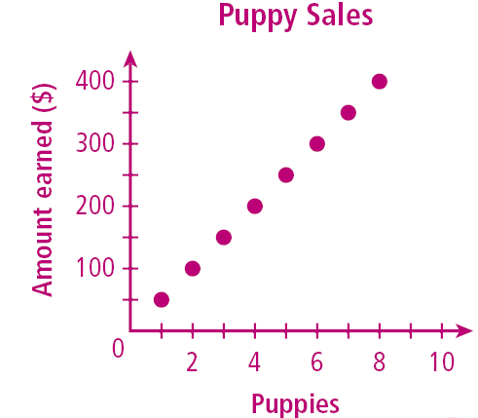
Lesson Quiz: Part II
2. A pet store is selling puppies for $50 each. It has 8 puppies to sell. Sketch a graph for this situation.

